Slide 1
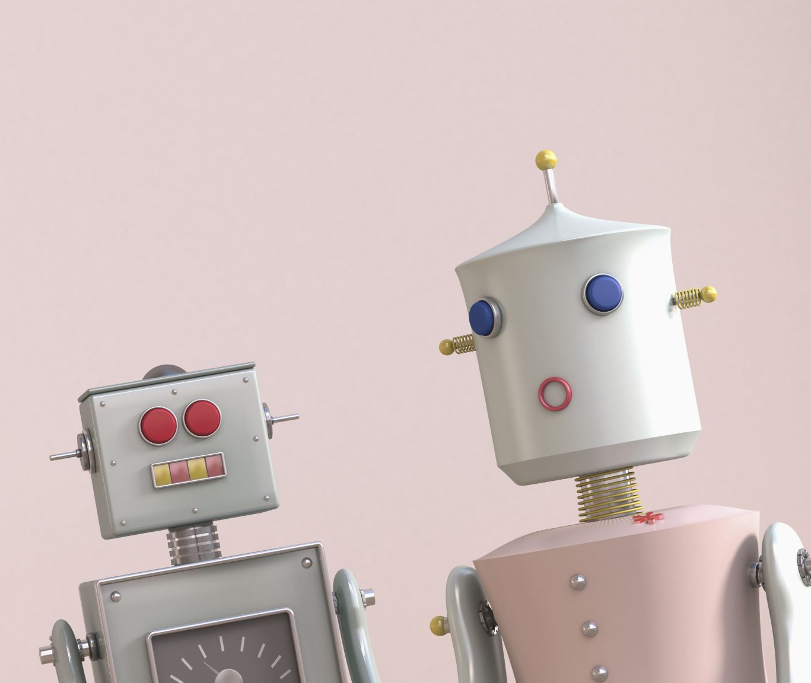
SparkyBot
Chat bot and voice assistant

Slide 2
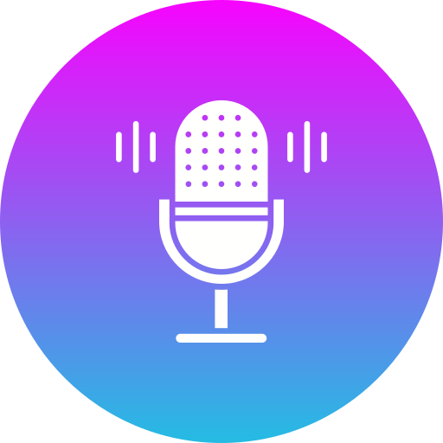
SparkyBot (Mobile application Made in Flutter) created By- GeeK NaVy

Slide 3
Introduction
"SparkyBot is an innovative application powered by the OpenAI API key, designed to revolutionize the way users interact with technology. This cutting-edge application leverages the power of artificial intelligence to provide seamless speech-to-text voice recognition, offering users a natural and intuitive interface for communication.”
With SparkyBot, users can effortlessly convert spoken words into text, enabling hands-free interaction and enhancing accessibility. Whether you're on the go, multitasking, or seeking a more convenient way to input information, SparkyBot is your intelligent assistant.

Slide 4
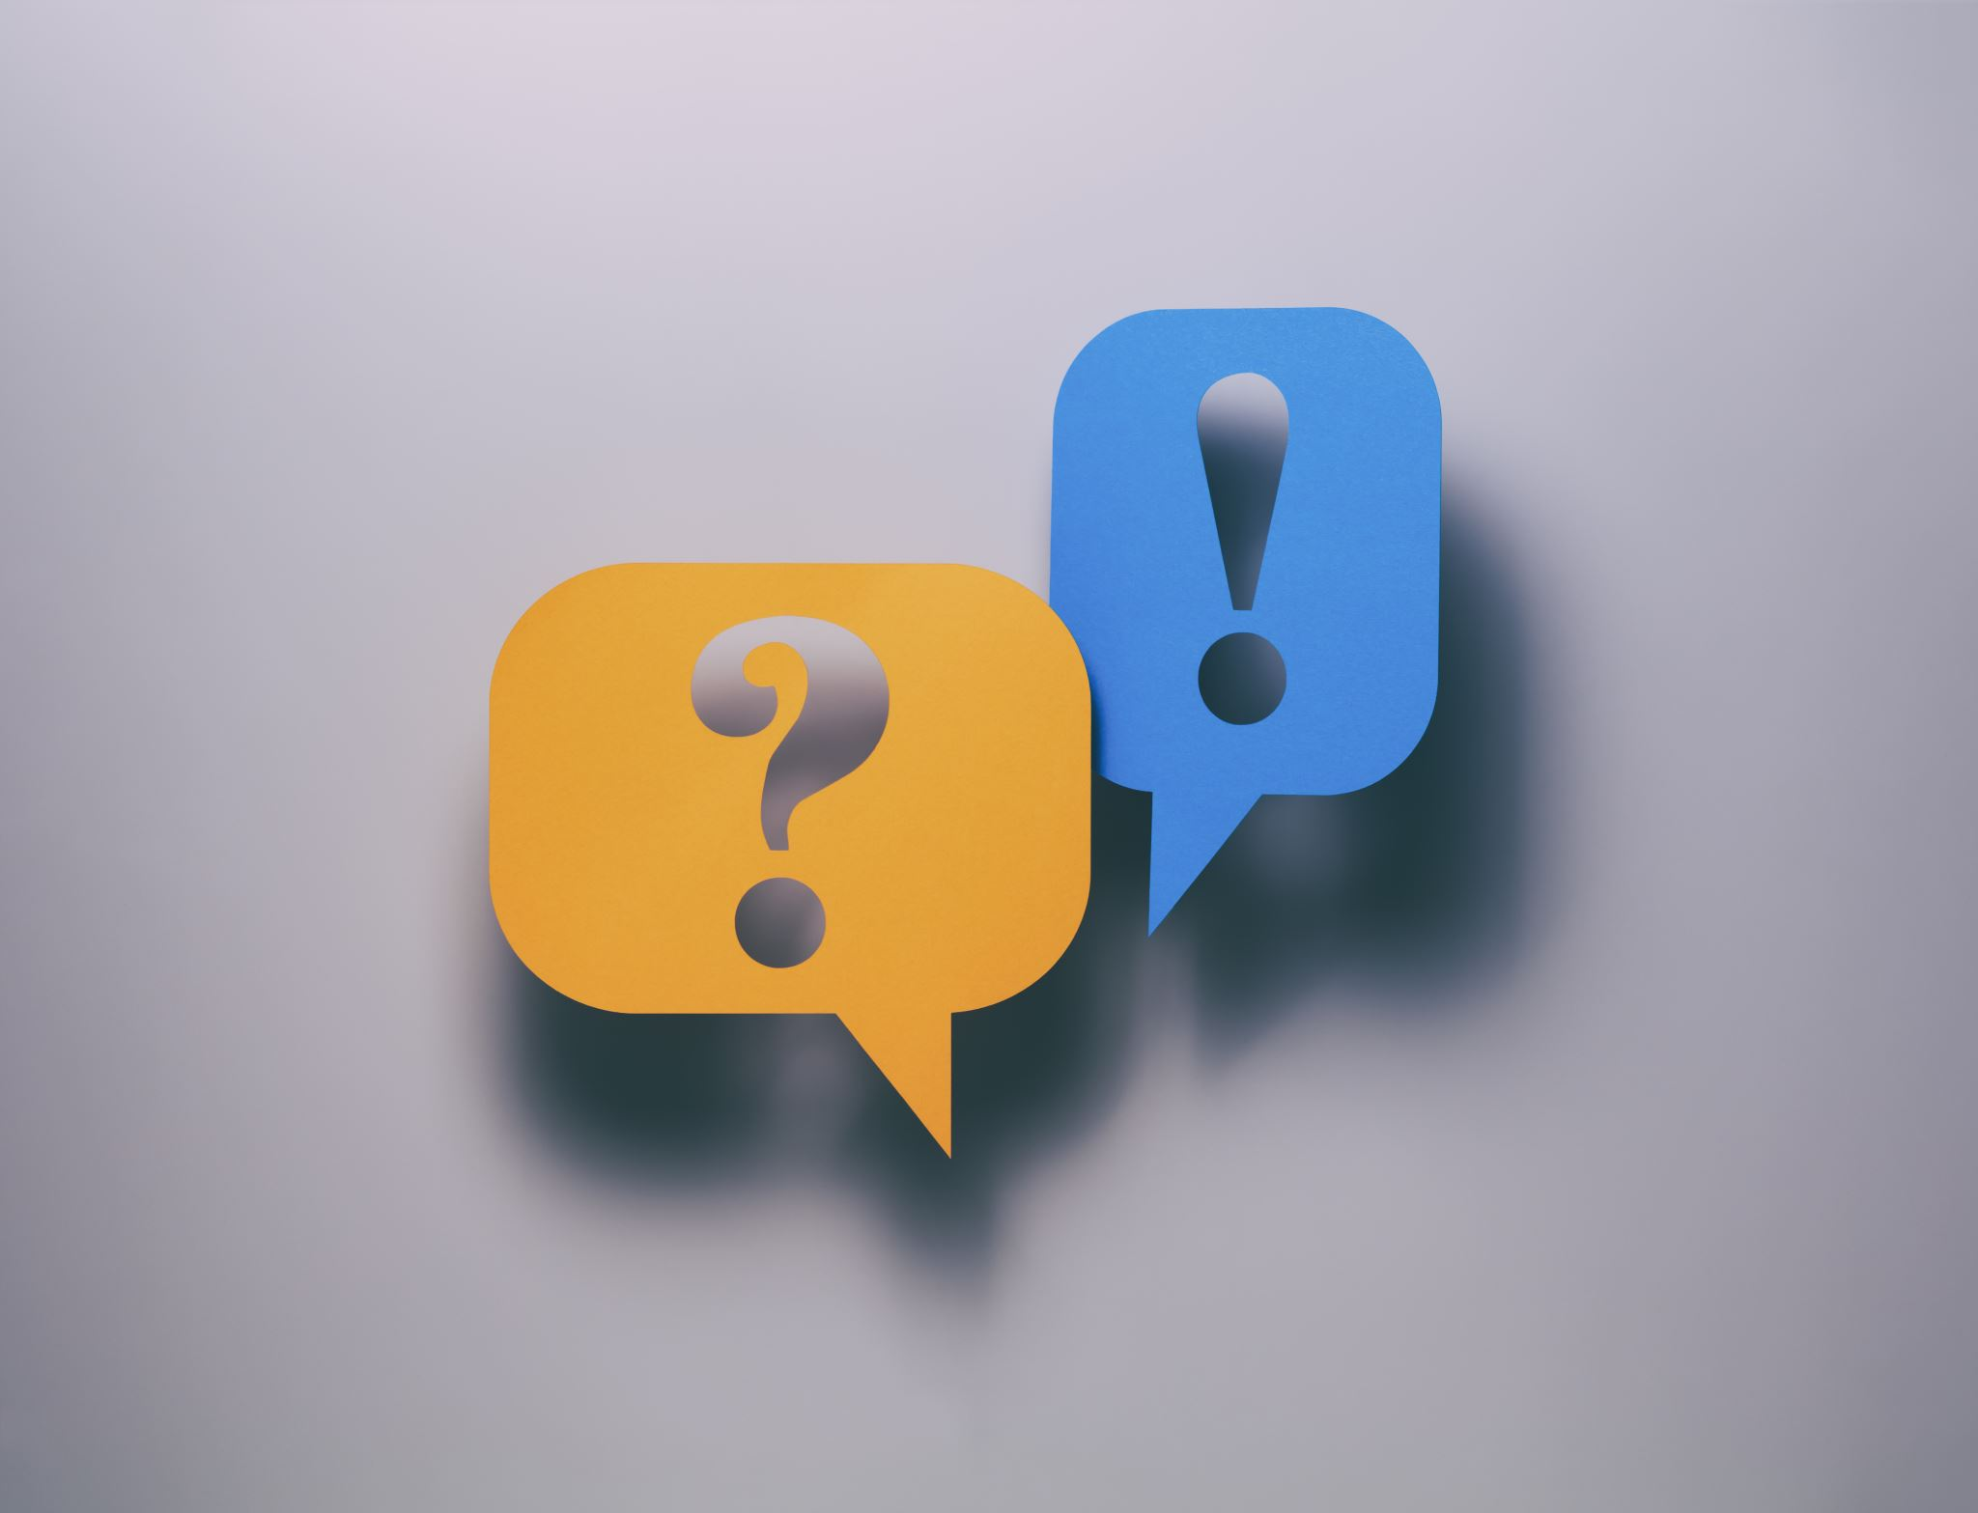
Our key features
Speech-to-Text Conversion
OpenAI Integration
Voice and Text Output
Versatility
App based system

Slide 5
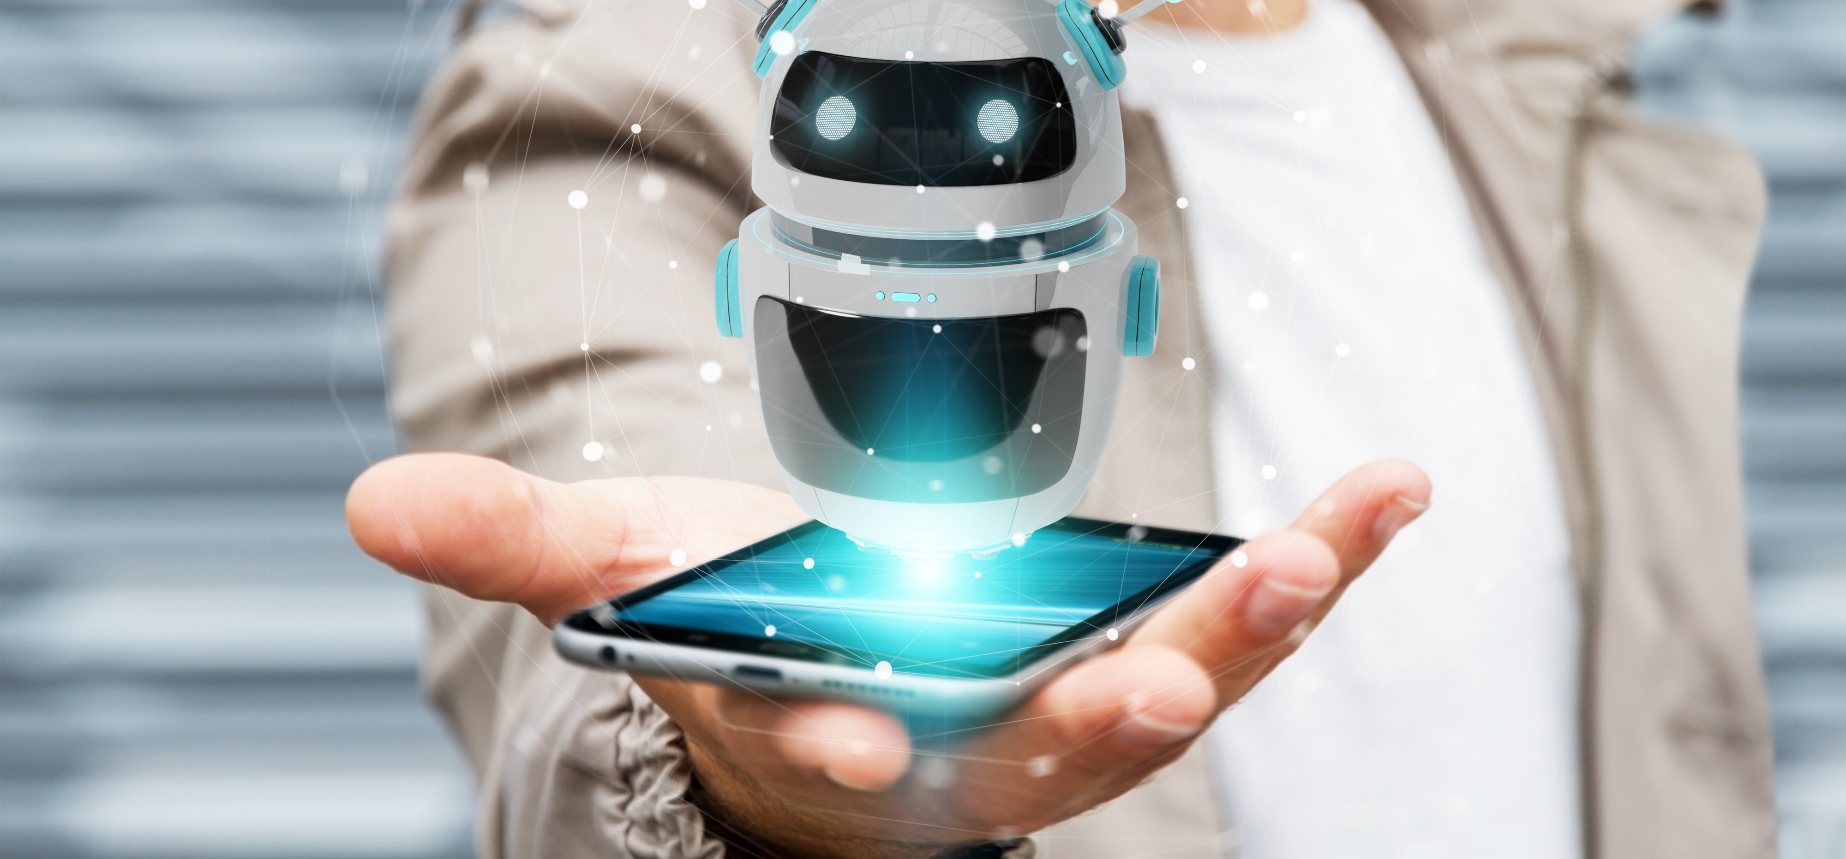
Before advent of SparkyBot

Slide 6
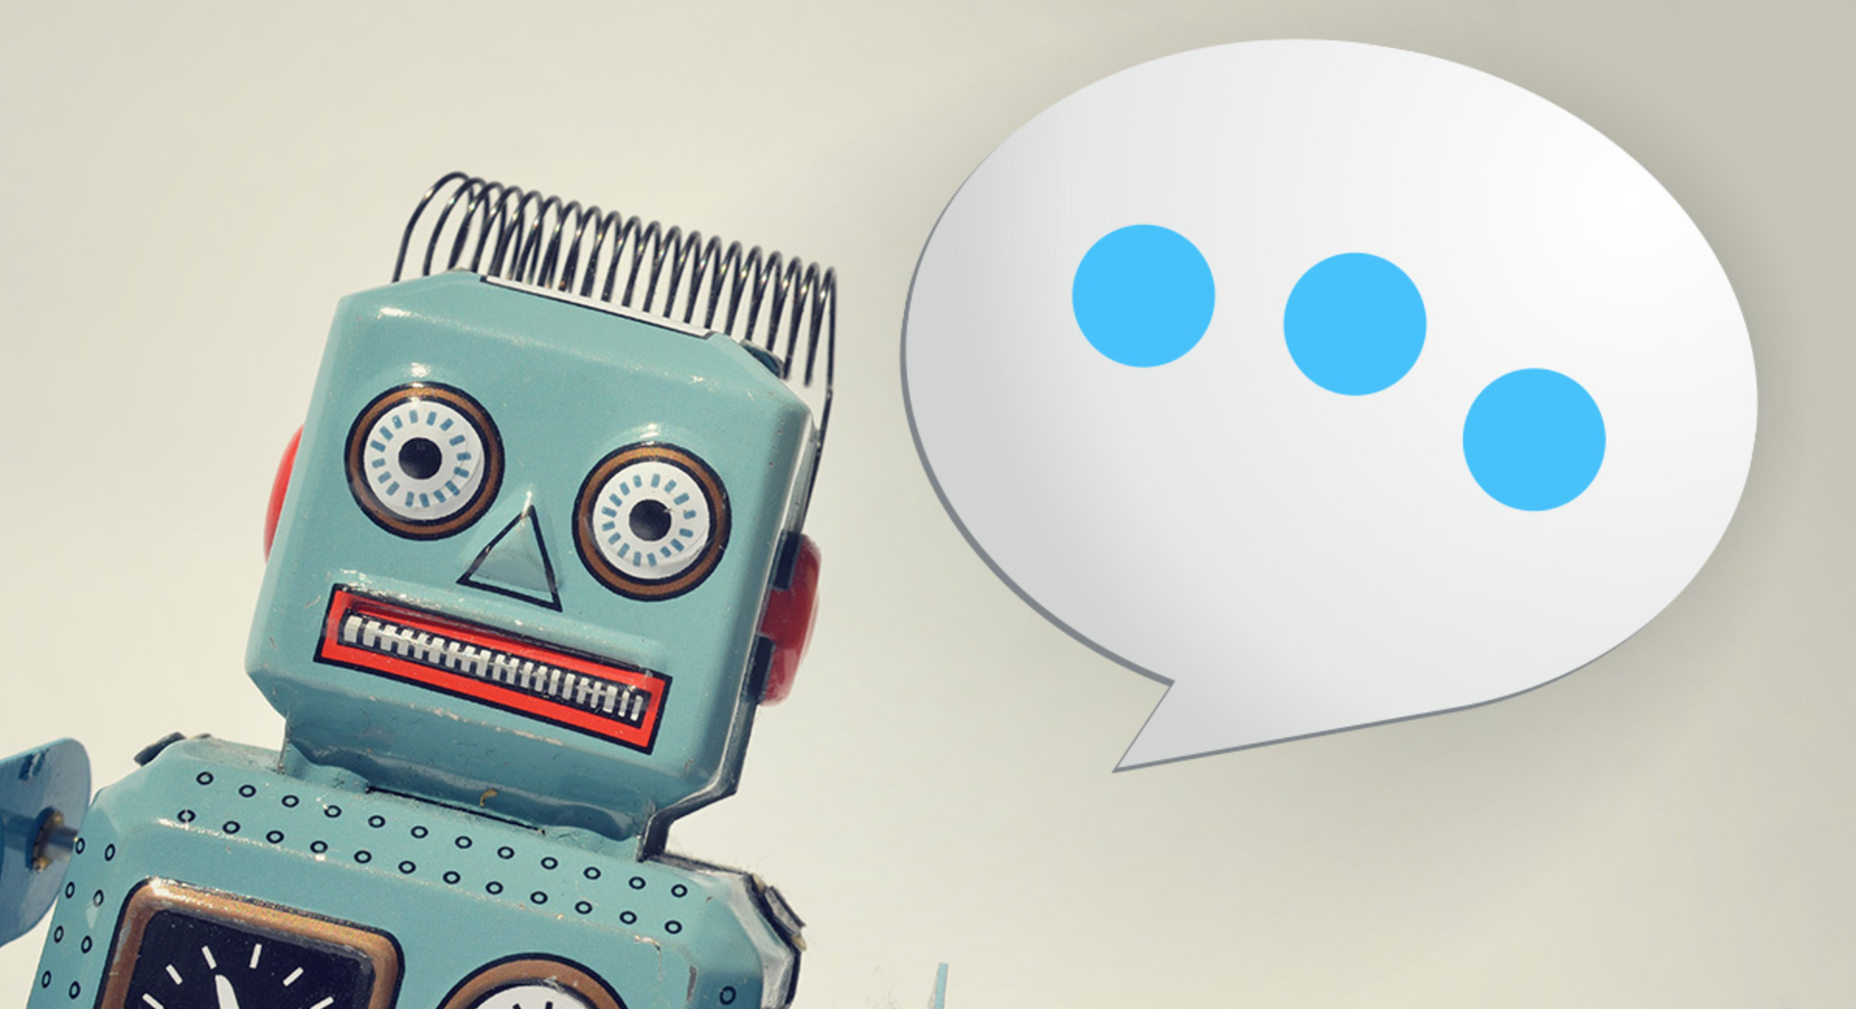
Problems Faced before Sparkybot
Manual Research and Learning
Time-Consuming Communication
Accessibility for People with Disabilities
Inefficient Search Processes
Lack of Personalized Learning
Limited Access to Experts

Slide 7
Solution To the Problem
Instant Information Retrieval
Automated Learning Assistance
Efficient Communication
Global Learning Opportunities
Voice assistant makes it more efficient
Accessibility Features
Broad access to information
English speaker with zero ability to read and write

Slide 8

Software development Methodology
SparkyBot uses agile methodology and it is flexible to accommodate changes in requirements even late in the development process. SparkyBot allows for adaptability and frequent updates, which is Agile trait.

Slide 9
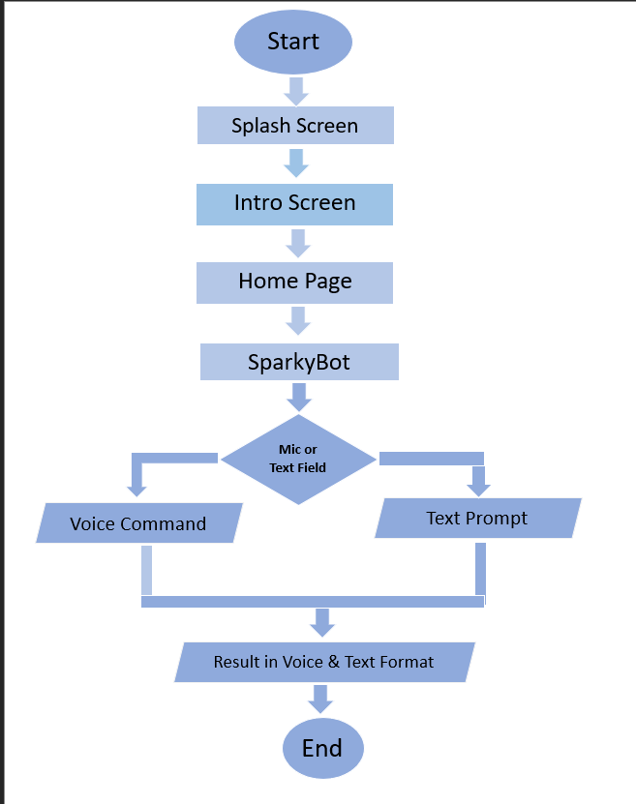
General flowchart of project

Slide 10
Future work
Multilingual
Navigating to different app and sites on command
Smart assistant
Generate Image and videos on voice command and according to demand and needs

Slide 11
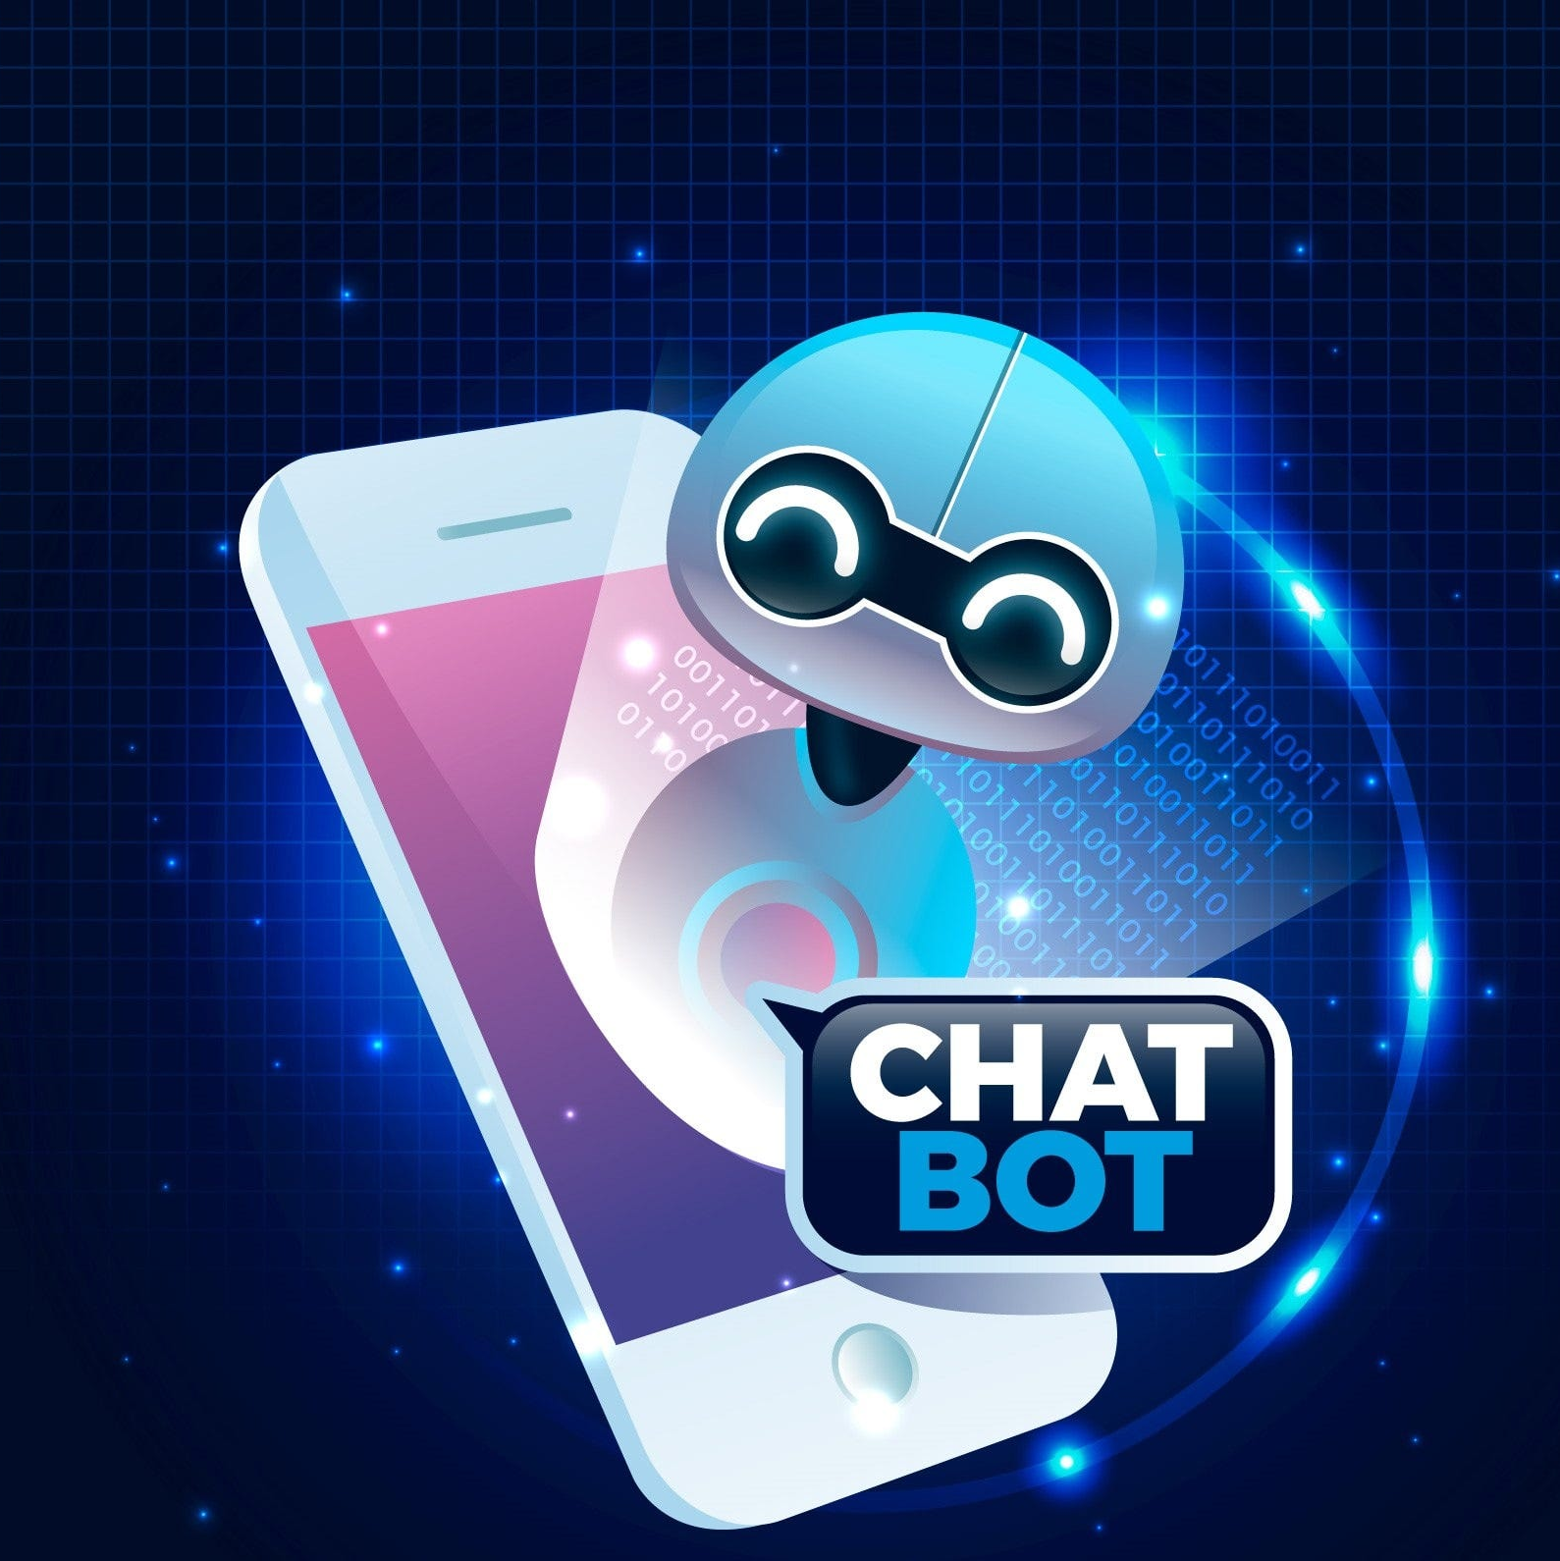
Conclusion
"SparkyBotis a groundbreaking application that not only excels in speech-to-text voice recognition but also delivers an immersive experience by generating human-like speech in both voice and text forms. This intelligent assistant redefines the way users engage with technology, combining the power of artificial intelligence with natural language processing.”

Slide 12
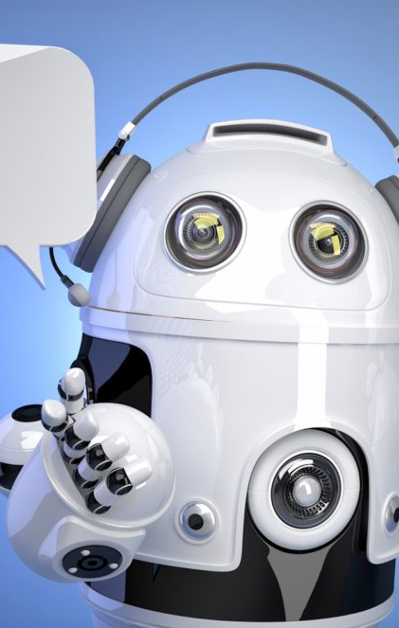
References
https://pub.dev/packages/speech_to_text
https://pub.dev/packages/text_to_speech
https://openai.com/

Slide 13


